Slide 1
Python Programming

Slide 2
Python
Goals
Regular Expressions
Decorators
Iterators and Generators
Collections Framework
Meta Class
Sockets

Slide 3
Python
Goals
Networking
Threading
Processes
Signal Handling
Unit Testing
Image Handling

Slide 4
Python
Goals
Creational Patterns
Structural Patterns
Behavioral Patterns

Slide 5
Regular Expressions
A regular expression is a special sequence of characters that helps you match or find other strings or sets of strings, using a specialized syntax held in a pattern.
Regular expressions are widely used in UNIX world.
The module re provides full support for Perl-like regular expressions in Python.
The re module raises the exception re.error if an error occurs while compiling or using a regular expression

Slide 6
Regular Expressions
A regular expression is a pattern of text that consists of ordinary characters (for example, letters a through z or numbers 0 through 9) and special characters known as meta characters.
This pattern describes the strings that would match when applied to a text.

Slide 7
Regular Expressions - Literals
Literals are the simplest form of pattern matching in regular expressions.
They will simply succeed whenever that literal is found.
If we apply the regular expression /fox/ to search the phrase The quick brown fox jumps over the lazy dog, we will find one match:

Slide 8
Regular Expressions - Literals
However, we can also obtain several results instead of just one, if we apply the
regular expression /be/ to the following phrase To be, or not to be:

Slide 9
Regular Expressions - Literals
Using the backslash method, we can convert the previous expression to /\(this is inside\)/ and apply it again to the same text to have the parentheses included in the result:

Slide 10
Regular Expression
In regular expressions, there are twelve meta characters that should be escaped if they are to be used with their literal meaning:
Backslash \
• Caret ^
• Dollar sign $
• Dot .

Slide 11
Regular Expression
Pipe symbol |
• Question mark ?
• Asterisk *
• Plus sign +
• Opening parenthesis (
• Closing parenthesis )
• Opening square bracket [
• The opening curly brace {

Slide 12
Regular Expressions Character classes
The character classes (also known as character sets) allow us to define a character that will match if any of the defined characters on the set is present.
To define a character class, we should use the opening square bracket meta character [, then any accepted characters, and finally close with a closing square bracket ].
For instance, let's define a regular expression that can match the word "license" in British and American English written form:

Slide 13
Regular Expressions Character classes
It is possible to also use the range of a character.
This is done by leveraging the hyphen symbol (-) between two related characters; for example, to match any lowercase letter we can use [a-z].
Likewise, to match any single digit we can define the character set [0-9].

Slide 14
Regular Expression
The character classes' ranges can be combined to be able to match a character against many ranges by just putting one range after the other—no special separation is required.
For instance, if we want to match any lowercase or uppercase alphanumeric character, we can use [0-9a-zA-Z] (see next table for a more detailed explanation).
This can be alternatively written using the union mechanism: [0-9[a-z[A-Z]]].

Slide 15
Predefined character classes

Slide 16
Predefined character classes

Slide 17
Quantifiers

Slide 18
Boundary Matchers

Slide 19
Boundary Matchers

Slide 20
Boundary Matchers

Slide 21
Boundary Matchers

Slide 22
Boundary Matchers

Slide 23
Functions

Slide 24
Regular Expressions
[] | A set of characters | "[a-m]"
\ | Signals a special sequence (can also be used to escape special characters) | "\d"
. | Any character (except newline character) | "he..o"
^ | Starts with | "^hello"
$ | Ends with | "world$"
* | Zero or more occurrences | "aix*"
+ | One or more occurrences | "aix+"
{} | Excactly the specified number of occurrences | "al{2}"
| | Either or | "falls|stays"
() | Capture and group

Slide 25
Regular Expressions
Character | Description | Example
\A | Returns a match if the specified characters are at the beginning of the string | "\AThe"
\b | Returns a match where the specified characters are at the beginning or at the end of a word | r"\bain" r"ain\b"
\B | Returns a match where the specified characters are present, but NOT at the beginning (or at the end) of a word | r"\Bain" r"ain\B"
\d | Returns a match where the string contains digits (numbers from 0-9) | "\d"
\D | Returns a match where the string DOES NOT contain digits | "\D"
\s | Returns a match where the string contains a white space character | "\s"
\S | Returns a match where the string DOES NOT contain a white space character | "\S"
\w | Returns a match where the string contains any word characters (characters from a to Z, digits from 0-9, and the underscore _ character) | "\w"
\W | Returns a match where the string DOES NOT contain any word characters | "\W"
\Z | Returns a match if the specified characters are at the end of the string | "Spain\Z"

Slide 26
Regular Expressions
Set | Description
[arn] | Returns a match where one of the specified characters (a, r, or n) are present
[a-n] | Returns a match for any lower case character, alphabetically between a and n
[^arn] | Returns a match for any character EXCEPT a, r, and n
[0123] | Returns a match where any of the specified digits (0, 1, 2, or 3) are present
[0-9] | Returns a match for any digit between 0 and 9
[0-5][0-9] | Returns a match for any two-digit numbers from 00 and 59
[a-zA-Z] | Returns a match for any character alphabetically between a and z, lower case OR upper case
[+] | In sets, +, *, ., |, (), $,{} has no special meaning, so [+] means: return a match for any +character in the string

Slide 27
Regular Expression
Expression | String | Matched?
^a...s$ | abs | No match
 | alias | Match
 | abyss | Match
 | Alias | No match
 | An abacus | No match

Slide 28
Regular Expression Meta Characters
[] - Square brackets
Square brackets specifies a set of characters you wish to match.
Expression | String | Matched?
[abc] | a | 1 match
 | ac | 2 matches
 | Hey Jude | No match
 | abc de ca | 5 matches

Slide 29
Regular Expression Meta Characters
. - Period
A period matches any single character (except newline '\n').
Expression | String | Matched?
.. | a | No match
 | ac | 1 match
 | acd | 1 match
 | acde | 2 matches (contains 4 characters)

Slide 30
Regular Expression Meta Characters
^ - Caret
The caret symbol ^ is used to check if a string starts with a certain character.
Expression | String | Matched?
^a | a | 1 match
 | abc | 1 match
 | bac | No match
^ab | abc | 1 match
 | acb | No match (starts with a but not followed by b)

Slide 31
Regular Expression Meta Characters
$ - Dollar
The dollar symbol $ is used to check if a string ends with a certain character..
Expression | String | Matched?
a$ | a | 1 match
 | formula | 1 match
 | cab | No match

Slide 32
Regular Expression Meta Characters
* - Star
The star symbol * matches zero or more occurrences of the pattern left to it..
Expression | String | Matched?
ma*n | mn | 1 match
 | man | 1 match
 | maaan | 1 match
 | main | No match (a is not followed by n)
 | woman | 1 match

Slide 33
Regular Expression Meta Characters
+ - Plus
The plus symbol + matches one or more occurrences of the pattern left to it.
Expression | String | Matched?
ma+n | mn | No match (no a character)
 | man | 1 match
 | maaan | 1 match
 | main | No match (a is not followed by n)
 | woman | 1 match

Slide 34
Regular Expression Meta Characters
? - Question Mark
The question mark symbol ? matches zero or one occurrence of the pattern left to it.
Expression | String | Matched?
ma?n | mn | 1 match
 | man | 1 match
 | maaan | No match (more than one a character)
 | main | No match (a is not followed by n)
 | woman | 1 match

Slide 35
Regular Expression Meta Characters
{} - Braces
Consider this code: {n,m}. This means at least n, and at most m repetitions of the pattern left to it.
Expression | String | Matched?
a{2,3} | abc dat | No match
 | abc daat | 1 match (at daat)
 | aabc daaat | 2 matches (at aabc and daaat)
 | aabc daaaat | 2 matches (at aabc and daaaat)

Slide 36
Regular Expression Meta Characters
Special Sequences
Special sequences make commonly used patterns easier to write. Here's a list of special sequences:
\A - Matches if the specified characters are at the start of a string.
Expression | String | Matched?
\Athe | the sun | Match
 | In the sun | No match

Slide 37
Regular Expression Meta Characters
\b - Matches if the specified characters are at the beginning or end of a word.
Expression | String | Matched?
\bfoo | football | Match
 | a football | Match
 | afootball | No match
foo\b | the foo | Match
 | the afoo test | Match
 | the afootest | No match

Slide 38
Regular Expression Meta Characters
\B - Opposite of \b. Matches if the specified characters are not at the beginning or end of a word.
Expression | String | Matched?
\Bfoo | football | No match
 | a football | No match
 | afootball | Match
foo\B | the foo | No match
 | the afoo test | No match
 | the afootest | Match

Slide 39
Regular Expression Meta Characters
\d - Matches any decimal digit. Equivalent to [0-9]
Expression | String | Matched?
\d | 12abc3 | 3 matches (at 12abc3)
 | Python | No match

Slide 40
Regular Expression Meta Characters
\D - Matches any non-decimal digit. Equivalent to [^0-9]
Expression | String | Matched?
\D | 1ab34"50 | 3 matches (at 1ab34"50)
 | 1345 | No match

Slide 41
Regular Expression Meta Characters
\s - Matches where a string contains any whitespace character. Equivalent to [ \t\n\r\f\v].
Expression | String | Matched?
\s | Python RegEx | 1 match
 | PythonRegEx | No match

Slide 42
Regular Expression Meta Characters
\w - Matches any alphanumeric character (digits and alphabets). Equivalent to [a-zA-Z0-9_]. By the way, underscore _ is also considered an alphanumeric character.
Expression | String | Matched?
\w | 12&": ;c | 3 matches (at 12&": ;c)
 | %"> ! | No match

Slide 43
Regular Expression Meta Characters
\Z - Matches if the specified characters are at the end of a string.
Expression | String | Matched?
\ZPython | I like Python | 1 match
 | I like Python | No match
 | Python is fun. | No match

Slide 44
Regular Expression
re.findall()
The re.findall() method returns a list of strings containing all matches.
string = 'hello 12 hi 89. Howdy 34'
pattern = '\d+'
result = re.findall(pattern, string)
print(result)
# Output: ['12', '89', '34']

Slide 45
Regular Expression
re.split()
The re.split method splits the string where there is a match and returns a list of strings where the splits have occurred.
string = 'Twelve:12 Eighty nine:89.'
pattern = '\d+'
result = re.split(pattern, string)
print(result)
# Output: ['Twelve:', ' Eighty nine:', '.']

Slide 46
Regular Expression
re.split()
The re.split method splits the string where there is a match and returns a list of strings where the splits have occurred.
string = 'Twelve:12 Eighty nine:89.'
pattern = '\d+'
result = re.split(pattern, string)
print(result)
# Output: ['Twelve:', ' Eighty nine:', '.']

Slide 47
Regular Expression
re.split()
The re.split method splits the string where there is a match and returns a list of strings where the splits have occurred.
string = 'Twelve:12 Eighty nine:89 Nine:9.'
pattern = '\d+'
# maxsplit = 1
# split only at the first occurrence
result = re.split(pattern, string, 1)
print(result)
# Output: ['Twelve:', ' Eighty nine:89 Nine:9.']

Slide 48
Regular Expression
re.sub()
The syntax of re.sub() is:
re.sub(pattern, replace, string)
The method returns a string where matched occurrences are replaced with the content of replace variable.
multiline string
string = 'abc 12\
de 23 \n f45 6'
# matches all whitespace characters
pattern = '\s+'
# empty string
replace = ''
new_string = re.sub(pattern, replace, string)
print(new_string)
# Output: abc12de23f456

Slide 49
Regular Expression
re.sub()
The syntax of re.sub() is:
re.sub(pattern, replace, string)
The method returns a string where matched occurrences are replaced with the content of replace variable.
# multiline string
string = 'abc 12\
de 23 \n f45 6'
# matches all whitespace characters
pattern = '\s+'
replace = ''
new_string = re.sub(r'\s+', replace, string, 1)
print(new_string)
# Output:
# abc12de 23
# f45 6

Slide 50
Regular Expression
re.subn()
The re.subn() is similar to re.sub() expect it returns a tuple of 2 items containing the new string and the number of substitutions made..
# multiline string
string = 'abc 12\
de 23 \n f45 6'
# matches all whitespace characters
pattern = '\s+'
# empty string
replace = ‘ ‘
new_string = re.subn(pattern, replace, string)
print(new_string)
# Output: ('abc12de23f456', 4)

Slide 51
Regular Expression
re.search()
The re.search() method takes two arguments: a pattern and a string. The method looks for the first location where the RegEx pattern produces a match with the string.
If the search is successful, re.search() returns a match object; if not, it returns None.
match = re.search(pattern, str)

Slide 52
Regular Expression
string = "Python is fun"
# check if 'Python' is at the beginning
match = re.search('\APython', string)
if match:
print("pattern found inside the string")
else:
print("pattern not found")
# Output: pattern found inside the string

Slide 53
Regular Expression
Match object
You can get methods and attributes of a match object using dir() function.
Some of the commonly used methods and attributes of match objects are:
match.group()
The group() method returns the part of the string where there is a match.

Slide 54
Regular Expression
string = '39801 356, 2102 1111'
# Three digit number followed by space followed by two digit number
pattern = '(\d{3}) (\d{2})'
# match variable contains a Match object.
match = re.search(pattern, string)
if match:
print(match.group())
else:
print("pattern not found")
# Output: 801 35

Slide 55
Decorators
Decorators allow you to inject or modify code in functions or classes.
Sounds a bit like Aspect-Oriented Programming (AOP) in Java, doesn’t it? Except that it’s both much simpler and (as a result) much more powerful.
For example, suppose you’d like to do something at the entry and exit points of a function.
A decorator in Python is any callable Python object that is used to modify a function or a class.

Slide 56
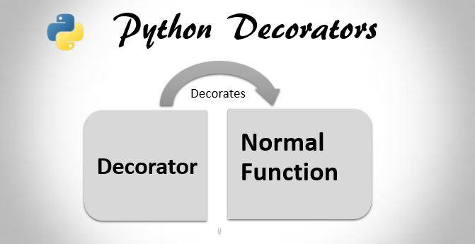
Decorators
we have two different kinds of decorators in Python:
Function decorators
Class decorators

Slide 57
Decorators
Function Decorators
A function decorator is applied to a function definition by placing it on the line before that function definition begins.
@myDecorator
def aFunction():
print("inside aFunction")
When the compiler passes over this code, aFunction() is compiled and the resulting function object is passed to the myDecorator code, which does something to produce a function-like object that is then substituted for the original aFunction().

Slide 58
Decorators
The only constraint upon the object returned by the decorator is that it can be used as a function – which
basically means it must be callable. Thus, any classes we use as decorators must implement __call__.

Slide 59
Iterators
Iterators are everywhere in Python. They are elegantly implemented within for loops, comprehensions, generators etc. but hidden in plain sight.
Iterator in Python is simply an object that can be iterated upon. An object which will return data, one element at a time.
Technically speaking, Python iterator object must implement two special methods, __iter__() and __next__(), collectively called the iterator protocol.
An object is called iterable if we can get an iterator from it. Most of built-in containers in Python like: list, tuple, string etc. are iterables.
The iter() function (which in turn calls the __iter__() method) returns an iterator from them.

Slide 60
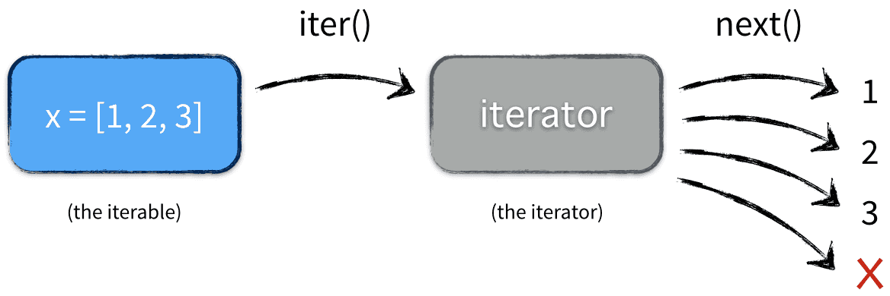
Iterators
Iterators have several advantages:
Cleaner code
Iterators can work with infinite sequences
Iterators save resources
Python has several built-in objects, which implement the iterator protocol. For example lists, tuples, strings, dictionaries or files

Slide 61
Generators
Generator is a special routine that can be used to control the iteration behaviour of a loop.
A generator is similar to a function returning an array.
A generator has parameters, it can be called and it generates a sequence of numbers.
But unlike functions, which return a whole array, a generator yields one value at a time. This requires less memory.

Slide 62
Generators
Generators in Python:
Are defined with the def keyword
Use the yield keyword
May use several yield keywords
Return an iterator

Slide 63
Generators vs Iterators
While creating a Python Generator, we use function. But to create an iterator in Python we use iter() and next() functions.
A generator use ‘yield’ keyword which Python iterator doesn't.
Python Generator saves the state of local variable every time yield pauses the loop in python. Iterator dose not use local variables. It just needs iterable to iterate on.
A generator can have any number of ‘yield’ statement.
You cam implement your own iterator using python class. A generator does not need a class.
You can either use a Python function or a comprehension to write Python Generator. For iterator you have to use iter() and next() functions.
We can write fast and compact code with Python Generator. This is an advantage over python iterators. They are also simpler to code than iterators.

Slide 64
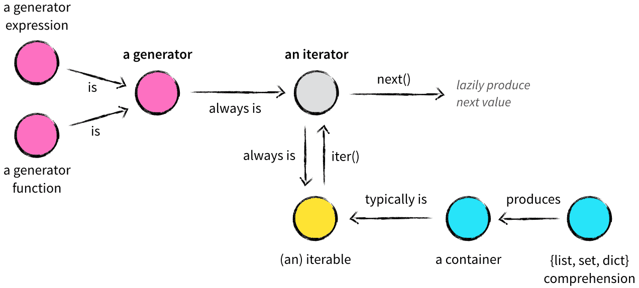
Generators vs Iterators

Slide 65
Collections Framework
Collections in Python are containers that are used to store collections of data, for example, list, dict, set, tuple etc.
These are built-in collections.
Several modules have been developed that provide additional data structures to store collections of data.
One such module is the Python collections module.

Slide 66
Collections Module
Counter
defaultdict
OrderedDict
deque
ChainMap
namedtuple()

Slide 67
Collections Module
The Counter
Counter is a subclass of dictionary object.
The Counter() function in collections module takes an iterable or a mapping as the argument and returns a Dictionary.
In this dictionary, a key is an element in the iterable or the mapping and value is the number of times that element exists in the iterable or the mapping.
You have to import the Counter class before you can create a counter instance.

Slide 68
Collections Module
The Counter
Counter is a subclass of dictionary object.
The Counter() function in collections module takes an iterable or a mapping as the argument and returns a Dictionary.
In this dictionary, a key is an element in the iterable or the mapping and value is the number of times that element exists in the iterable or the mapping.
You have to import the Counter class before you can create a counter instance.

Slide 69
Collections Module
The defaultdict
The defaultdict works exactly like a python dictionary, except for it does not throw KeyError when you try to access a non-existent key.
Instead, it initializes the key with the element of the data type that you pass as an argument at the creation of defaultdict. The data type is called default_factory.

Slide 70
Collections Module
The OrderedDict
OrderedDict is a dictionary where keys maintain the order in which they are inserted, which means if you change the value of a key later, it will not change the position of the key.
The deque (Double Ended Queue)
The deque is a list optimized for inserting and removing items.

Slide 71
Collections Module
The ChainMap
ChainMap is used to combine several dictionaries or mappings. It returns a list of dictionaries.
The namedtuple()
The namedtuple() returns a tuple with names for each position in the tuple.
One of the biggest problems with ordinary tuples is that you have to remember the index of each field of a tuple object.
This is obviously difficult. The namedtuple was introduced to solve this problem.

Slide 72
Meta class
A metaclass is a class whose instances are classes. Like an "ordinary" class defines the behavior of the instances of the class, a metaclass defines the behavior of classes and their instances.
Metaclasses are not supported by every object oriented programming language. Those programming language, which support metaclasses, considerably vary in way the implement them. Python is supporting them

Slide 73
Meta Class
There are numerous use cases for metaclasses. Just to name a few:
logging and profiling
interface checking
registering classes at creation time
automatically adding new methods
automatic property creation
proxies
automatic resource locking/synchronization.

Slide 74
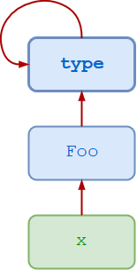
Meta Class

Slide 75
Dynamic Meta class
>>> type(3)
<class 'int'>
>>> type(['foo', 'bar', 'baz'])
<class 'list'>
>>> t = (1, 2, 3, 4, 5)
>>> type(t)
<class 'tuple'>

Slide 76
Dynamic Meta class
>>> class Foo:
... pass
...
>>> type(Foo())
<class '__main__.Foo'>

Slide 77
Dynamic Meta class
You can also call type() with three arguments—type(<name>, <bases>, <dct>):
<name> specifies the class name. This becomes the __name__ attribute of the class.
<bases> specifies a tuple of the base classes from which the class inherits. This becomes the __bases__ attribute of the class.
<dct> specifies a namespace dictionary containing definitions for the class body. This becomes the __dict__ attribute of the class.

Slide 78
Dynamic Meta class
>>> Bar = type('Bar', (Foo,), dict(attr=100))
>>> x = Bar()
>>> x.attr
100
>>> x.__class__
<class '__main__.Bar'>
>>> x.__class__.__bases__
(<class '__main__.Foo'>,)

Slide 79
Threads
In computing, a process is an instance of a computer program that is being executed.
Any process has 3 basic components:
An executable program.
The associated data needed by the program (variables, work space, buffers, etc.)
The execution context of the program (State of process)

Slide 80
Threads
A thread is an entity within a process that can be scheduled for execution. Also, it is the smallest unit of processing that can be performed in an OS (Operating System).
In simple words, a thread is a sequence of such instructions within a program that can be executed independently of other code. For simplicity, you can assume that a thread is simply a subset of a process!

Slide 81
Threads
A thread contains all this information in a Thread Control Block (TCB):
Thread Identifier: Unique id (TID) is assigned to every new thread
Stack pointer: Points to thread’s stack in the process. Stack contains the local variables under thread’s scope.
Program counter: a register which stores the address of the instruction currently being executed by thread.
Thread state: can be running, ready, waiting, start or done.
Thread’s register set: registers assigned to thread for computations.
Parent process Pointer: A pointer to the Process control block (PCB) of the process that the thread lives on.

Slide 82
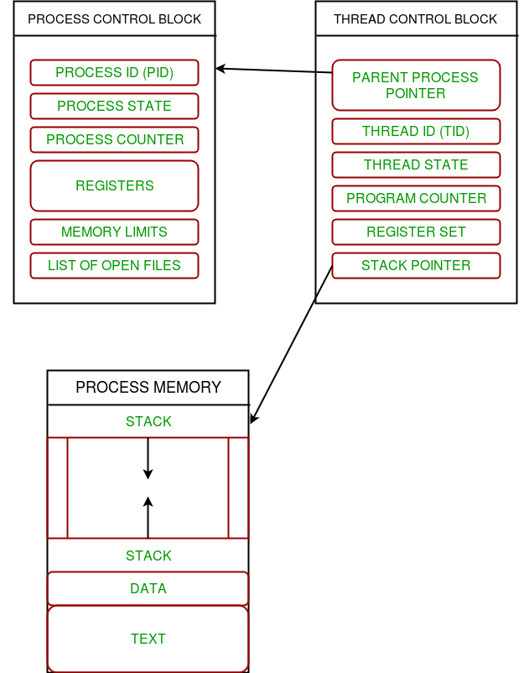
Threads

Slide 83
Threads
Multiple threads can exist within one process where:
Each thread contains its own register set and local variables (stored in stack).
All thread of a process share global variables (stored in heap) and the program code.
Consider the diagram below to understand how multiple threads exist in memory:

Slide 84
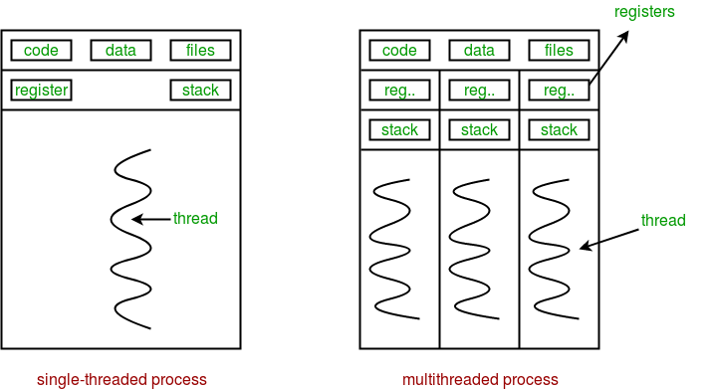
Threads

Slide 85
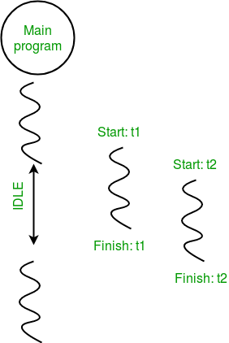
Threads

Slide 86
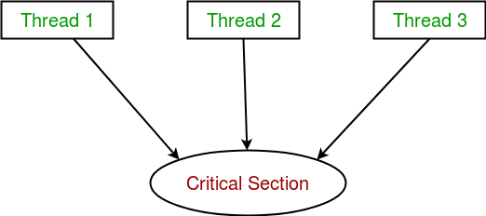
Multithreading in Python | Set 2 (Synchronization)
Thread synchronization is defined as a mechanism which ensures that two or more concurrent threads do not simultaneously execute some particular program segment known as critical section.

Slide 87
Multithreading
Advantages:
It doesn’t block the user. This is because threads are independent of each other.
Better use of system resources is possible since threads execute tasks parallely.
Enhanced performance on multi-processor machines.
Multi-threaded servers and interactive GUIs use multithreading exclusively.
Disadvantages:
As number of threads increase, complexity increases.
Synchronization of shared resources (objects, data) is necessary.
It is difficult to debug, result is sometimes unpredictable.
Potential deadlocks which leads to starvation, i.e. some threads may not be served with a bad design
Constructing and synchronizing threads is CPU/memory intensive.

Slide 88
Time class
Python has a module named time to handle time-related tasks.
To use functions defined in the module, we need to import the module first.
time.time()
time.ctime()
time.sleep()
time.struct_time Class
time.localtime()
time.gmtime()
time.mktime()
time.asctime()
time.strftime()
time.strptime()

Slide 89
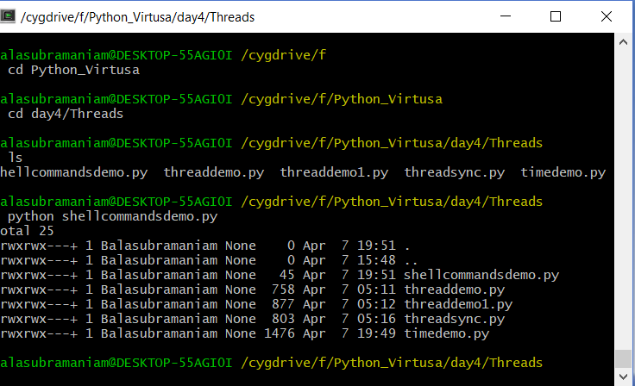
Shell Commands from Cygwin and Python

Slide 90
Parallel Processing
Python offers three possible ways to handle that.
First, you can execute functions in parallel using the multiprocessing module.
Second, an alternative to processes are threads.
Third, you can call external programs using the system() method of the os module, or methods provided by the subprocess module, and collect the results afterwards.

Slide 91
Parallel Processing
The multiprocessing module covers a nice selection of methods to handle the parallel execution of routines.
This includes processes, pools of agents, queues, and pipes.
What is Synchronous and Asynchronous execution?
In parallel processing, there are two types of execution: Synchronous and Asynchronous.
A synchronous execution is one the processes are completed in the same order in which it was started. This is achieved by locking the main program until the respective processes are finished.
Asynchronous, on the other hand, doesn’t involve locking. As a result, the order of results can get mixed up but usually gets done quicker.

Slide 92
Parallel Processing
There are 2 main objects in multiprocessing to implement parallel execution of a function: The Pool Class and the Process Class.
Pool Class
Synchronous execution
Pool.map() and Pool.starmap()
Pool.apply()
Asynchronous execution
Pool.map_async() and Pool.starmap_async()
Pool.apply_async())
Process Class

Slide 93
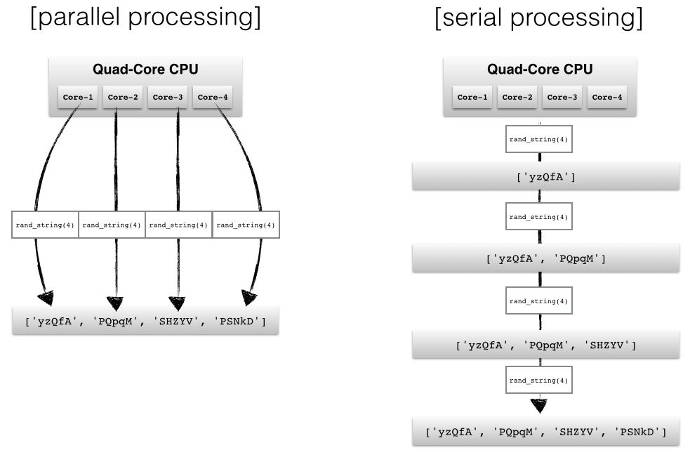
Parallel Processing

Slide 94
Parallel Processing
Steps to parallelize a function:
To parallelize a function, you need to execute it in various processors.
Start with initializing a pool with x number of processors.
Now, pass that function to any one of the parallelization methods of a pool.
The apply(), starmap() and map() methods of the multiprocessing.Pool() will allow you to execute functions parallelly.
Here, both map and apply functions are used to take the functions for parallelization as the main argument.
The only difference is that map() will only bring one iterable as an argument while the apply() collects args argument which takes the parameters of the parallelized function as an argument.

Slide 95
Re-entrant Locks
Normal Lock objects cannot be acquired more than once, even by the same thread.
This can introduce undesirable side-effects if a lock is accessed by more than one function in the same call chain.

Slide 96
Limiting Concurrent Access to Resources
Sometimes it is useful to allow more than one worker access to a resource at a time, while still limiting the overall number.
For example, a connection pool might support a fixed number of simultaneous connections, or a network application might support a fixed number of concurrent downloads.
A Semaphore is one way to manage those connections.

Slide 97
Limiting Concurrent Access to Resources
A semaphore is based on an internal counter which is decremented each time acquire() is called and incremented each time release() is called.
If the counter is equal to 0 then acquire() blocks. It is the Python implementation of the Dijkstra semaphore concept: P() and V().
Using a semaphore makes sense when you want to control access to a resource with limited capacity like a server..

Slide 98
Rentrant Lock
RLock is the reentrant lock provided by python.
A reentrant lock or simply RLock allows itself to be locked several times.
The RLock is released only after equal number release() calls as the acquire() calls made to it.
Unlike the primitive lock given by the Lock class the RLock can only be released by the thread holding the RLock.

Slide 99
Sockets, IPv4, and Simple Client/Server Programming
Python's socket module has both class-based and instances-based utilities.
The difference between a class-based and instance-based method is that the former doesn't need an instance of a socket object.
For example, in order to print your machine's IP address, you don't need a socket object. Instead, you can just call the socket's class-based methods.
On the other hand, if you need to send some data to a server application, it is more intuitive that you create a socket object to perform that explicit operation.

Slide 100
Sockets, IPv4, and Simple Client/Server Programming
The following is a list of those third-party libraries with their download URLs:
ff ntplib: https://pypi.python.org/pypi/ntplib/
ff diesel: https://pypi.python.org/pypi/diesel/
ff nmap: https://pypi.python.org/pypi/python-nmap
ff scapy: https://pypi.python.org/pypi/scapy
ff netifaces: https://pypi.python.org/pypi/netifaces/
ff netaddr: https://pypi.python.org/pypi/netaddr
ff pyopenssl: https://pypi.python.org/pypi/pyOpenSSL

Slide 101
Sockets, IPv4, and Simple Client/Server Programming
pygeocoder: https://pypi.python.org/pypi/pygocoder
ff pyyaml: https://pypi.python.org/pypi/PyYAML
ff requests: https://pypi.python.org/pypi/requests
ff feedparser: https://pypi.python.org/pypi/feedparser
ff paramiko: https://pypi.python.org/pypi/paramiko/
ff fabric: https://pypi.python.org/pypi/Fabric
ff supervisor: https://pypi.python.org/pypi/supervisor
ff xmlrpclib: https://pypi.python.org/pypi/xmlrpclib
ff SOAPpy: https://pypi.python.org/pypi/SOAPpy
ff bottlenose: https://pypi.python.org/pypi/bottlenose
ff construct: https://pypi.python.org/pypi/construct

Slide 102
Sockets and Networking
Socket programming is a way of connecting two nodes on a network to communicate with each other.
One socket(node) listens on a particular port at an IP, while other socket reaches out to the other to form a connection.
Server forms the listener socket while client reaches out to the server.
They are the real backbones behind web browsing. In simpler terms there is a server and a client.

Slide 103
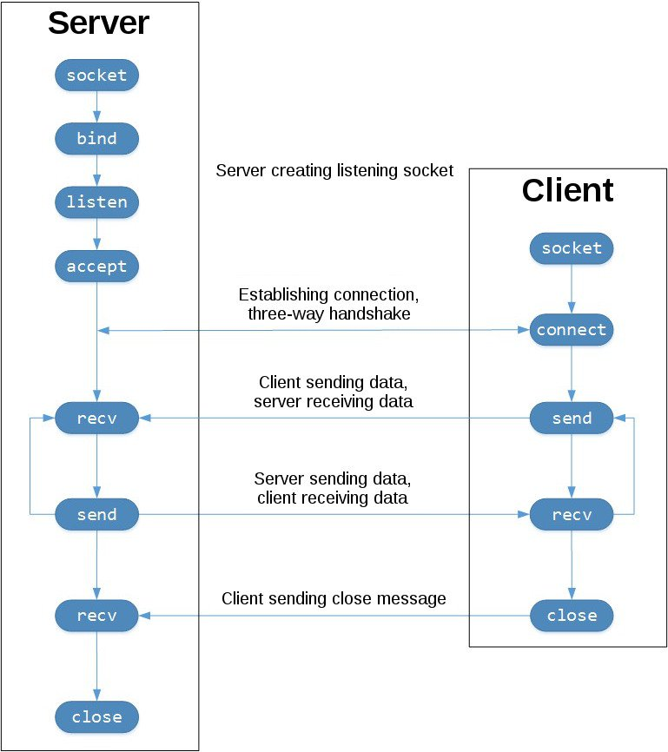
Sockets and Networking

Slide 104
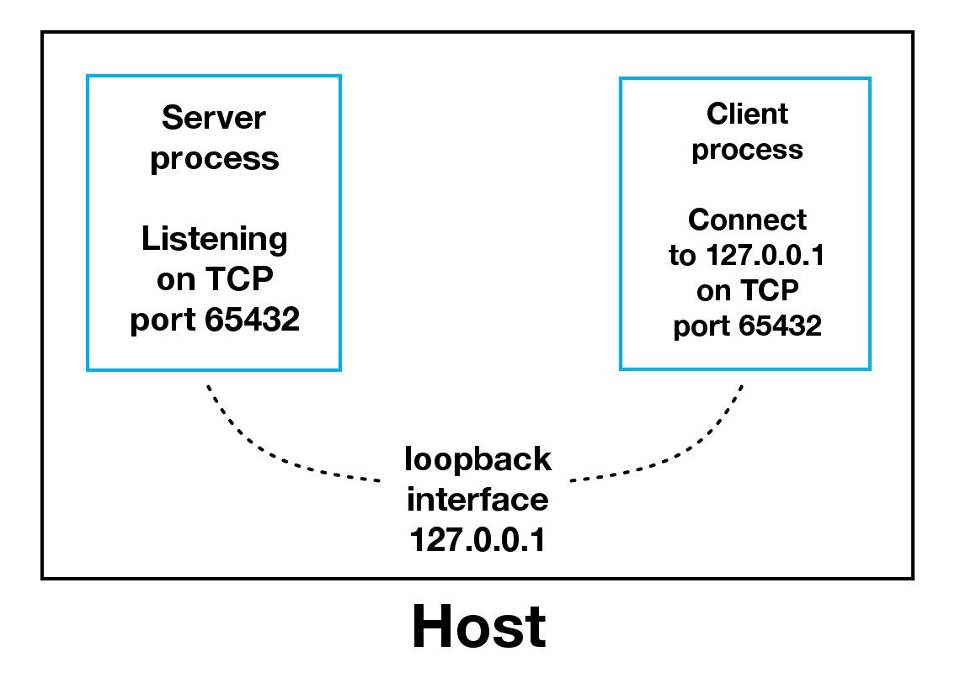
Sockets and Networking

Slide 105
Signal Handling
1 (SIGHUP): terminate a connection, or reload the configuration for daemons
2 (SIGINT): interrupt the session from the dialogue station
3 (SIGQUIT): terminate the session from the dialogue station
4 (SIGILL): illegal instruction was executed
5 (SIGTRAP): do a single instruction (trap)
6 (SIGABRT): abnormal termination
7 (SIGBUS): error on the system bus
8 (SIGFPE): floating point error
9 (SIGKILL): immmediately terminate the process
10 (SIGUSR1): user-defined signal
11 (SIGSEGV): segmentation fault due to illegal access of a memory segment
12 (SIGUSR2): user-defined signal
13 (SIGPIPE): writing into a pipe, and nobody is reading from it
14 (SIGALRM): the timer terminated (alarm)
15 (SIGTERM): terminate the process in a soft way

Slide 106
Twisted
The main idea behind Twisted is that it gives us the parallelism of multithreading programming with the ease of reasoning of single threaded programming.

Slide 107
Twisted
In 2000, glyph, the creator of Twisted, was working on a text-based multiplayer game called Twisted Reality.
It was a big mess of threads, 3 per connection, in Java.
There was a thread for input that would block on reads, a thread for output that would block on some kind of write, and a "logic" thread that would sleep while waiting for timers to expire or events to queue.
As players moved through the virtual landscape and interacted, threads were deadlocking, caches were getting corrupted, and the locking logic was never quite right—the use of threads had made the software complicated, buggy, and hard to scale.

Slide 108
Twisted
Over time, Twisted Reality the game became Twisted the networking platform, which would do what existing networking platforms in Python didn't:
Use event-driven programming instead of multi-threaded programming.
Be cross-platform: provide a uniform interface to the event notification systems exposed by major operating systems.
Be "batteries-included": provide implementations of popular application-layer protocols out of the box, so that Twisted is immediately useful to developers.
Conform to RFCs, and prove conformance with a robust test suite.
Make it easy to use multiple networking protocols together.
Be extensible.

Slide 109
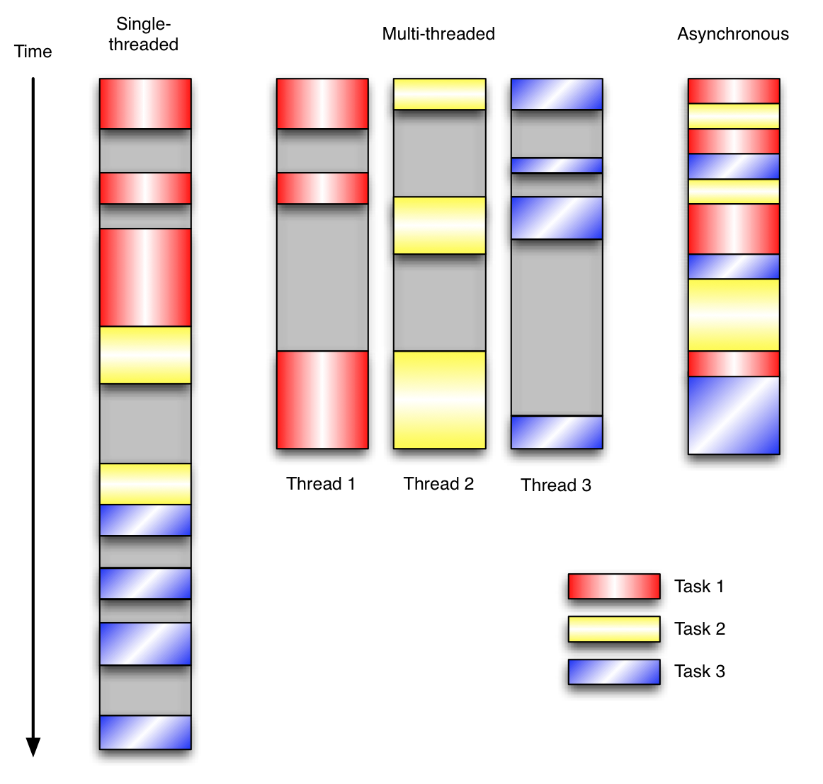
Twisted

Slide 110
Twisted Architecture
Twisted is an event-driven networking engine. Event-driven programming is so integral to Twisted's design philosophy that it is worth taking a moment to review what exactly event-driven programming means.
Event-driven programming is a programming paradigm in which program flow is determined by external events. It is characterized by an event loop and the use of callbacks to trigger actions when events happen. Two other common programming paradigms are (single-threaded) synchronous and multi-threaded programming.
Let's compare and contrast single-threaded, multi-threaded, and event-driven programming models with an example. Figure shows the work done by a program over time under these three models. The program has three tasks to complete, each of which blocks while waiting for I/O to finish. Time spent blocking on I/O is greyed out.

Slide 111
Twisted Architecture
In the single-threaded synchronous version of the program, tasks are performed serially.
If one task blocks for a while on I/O, all of the other tasks have to wait until it finishes and they are executed in turn.
This definite order and serial processing are easy to reason about, but the program is unnecessarily slow if the tasks don't depend on each other, yet still have to wait for each other.
In the threaded version of the program, the three tasks that block while doing work are performed in separate threads of control.
These threads are managed by the operating system and may run concurrently on multiple processors or interleaved on a single processor.
This allows progress to be made by some threads while others are blocking on resources. This is often more time-efficient than the analogous synchronous program,

Slide 112
Twisted Architecture
but one has to write code to protect shared resources that could be accessed concurrently from multiple threads.
Multi-threaded programs can be harder to reason about because one now has to worry about thread safety via process serialization (locking), reentrancy, thread-local storage, or other mechanisms, which when implemented improperly can lead to subtle and painful bugs.

Slide 113
Twisted Architecture
The event-driven version of the program interleaves the execution of the three tasks, but in a single thread of control.
When performing I/O or other expensive operations, a callback is registered with an event loop, and then execution continues while the I/O completes.
The callback describes how to handle an event once it has completed.
The event loop polls for events and dispatches them as they arrive, to the callbacks that are waiting for them.
This allows the program to make progress when it can without the use of additional threads.
Event-driven programs can be easier to reason about than multi-threaded programs because the programmer doesn't have to worry about thread safety.

Slide 114
Twisted Architecture
The event-driven model is often a good choice when there are:
many tasks, that are…
largely independent (so they don't have to communicate with or wait on each other), and…
some of these tasks block while waiting on events.

Slide 115
Twisted Architecture
Twisted implements the reactor design pattern, which describes demultiplexing and dispatching events from multiple sources to their handlers in a single-threaded environment.
The core of Twisted is the reactor event loop.
The reactor knows about network, file system, and timer events.
It waits on and then handles these events, abstracting away platform-specific behavior and presenting interfaces to make responding to events anywhere in the network stack easy.

Slide 116
Reactor
Reactor Basics
The reactor is the core of the event loop within Twisted – the loop which drives applications using Twisted.
The event loop is a programming construct that waits for and dispatches events or messages in a program.
It works by calling some internal or external “event provider”, which generally blocks until an event has arrived, and then calls the relevant event handler (“dispatches the event”).
The reactor provides basic interfaces to a number of services, including network communications, threading, and event dispatching.

Slide 117
Reactor
For information about using the reactor and the Twisted event loop, see:
the event dispatching how tos: Scheduling and Using Deferreds ;
the communication how tos: TCP servers , TCP clients , UDP networking and Using processes ; and
Using threads .

Slide 118
Reactor
The reactor usually implements a set of interfaces, but depending on the chosen reactor and the platform, some of the interfaces may not be implemented:
IReactorCore : Core (required) functionality.
IReactorFDSet : Use FileDescriptor objects.
IReactorProcess : Process management. Read the Using Processes document for more information.
IReactorSSL : SSL networking support.
IReactorTCP : TCP networking support. More information can be found in the Writing Servers and Writing Clients documents.
IReactorThreads : Threading use and management. More information can be found within Threading In Twisted .
IReactorTime : Scheduling interface. More information can be found within Scheduling Tasks .
IReactorUDP : UDP networking support. More information can be found within UDP Networking .
IReactorUNIX : UNIX socket support.
IReactorSocket : Third-party socket support..

Slide 119
Scipy
Python SciPy has modules for the following tasks:
Optimization
Linear algebra
Integration
Interpolation
Special functions
FFT
Signal and Image processing
ODE solvers

Slide 120
Scipy – sub packages
cluster- Hierarchical clustering.
constants- Physical constants and factors of conversion.
fftpack- Algorithms for Discrete Fourier Transform.
integrate- Routines for numerical integration.
interpolate- Tools for interpolation.
io- Input and Output tools for data.
lib- Wrappers to external libraries.
linalg- Routines for linear algebra.
misc- Miscellaneous utilities like image reading and writing.
ndimage- Functions for processing multidimensional images.
optimize- Algorithms for optimization.
signal- Tools for processing signal.
sparse- Algorithms for sparse matrices.
spatial- KD-trees, distance functions, nearest neighbors.
special- Special functions.
stats- Functions to perform statistics.
weave- Functionality that lets you write C++/C code in the form of multiline strings.

Slide 121
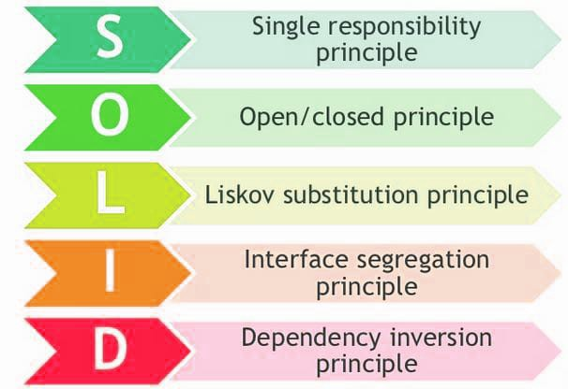
SOLID Design Pattern

Slide 122
Single Responsibility Principle
As the single responsibility principle states, a class should have only one reason to change.
This principle says that when we develop classes, it should cater to the given functionality well.
If a class is taking care of two functionalities, it is better to split them. It refers to functionality as a reason to change.

Slide 123
Single Responsibility Principle
Let's assume we need an object to keep an email message. We are going to use the IEmail interface. At the first sight everything looks just fine.
IEmail interface and Email class have 2 responsibilities (reasons to change). One would be the use of the class in some email protocols such as pop3 or imap.
If other protocols must be supported the objects should be serialized in another manner and code should be added to support new protocols.
Another one would be for the Content field. Even if content is a string maybe we want in the future to support HTML or other formats.
If we keep only one class, each change for a responsibility might affect the other one:
Adding a new protocol will create the need to add code for parsing and serializing the content for each type of field.
Adding a new content type (like html) make us to add code for each protocol implemented.

Slide 124
The open/close principle
The open/close principle states that classes or objects and methods should be open for extension but closed for modifications.
What this means in simple language is, when you develop your software application, make sure that you write your classes or modules in a generic way so that whenever you feel the need to extend the behavior of the class or object, then you shouldn't have to change the class itself.
Rather, a simple extension of the class should help you build the new behavior.

Slide 125
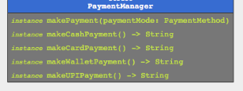
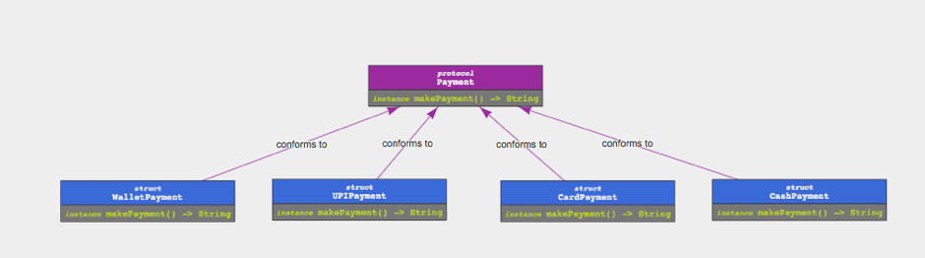
The open/close principle
Not applying open/close principle
Open close principle

Slide 126
The inversion of control principle
The inversion of control principle states that high-level modules shouldn't be dependent on low-level modules;
They should both be dependent on abstractions. Details should depend on abstractions and not the other way round.

Slide 127
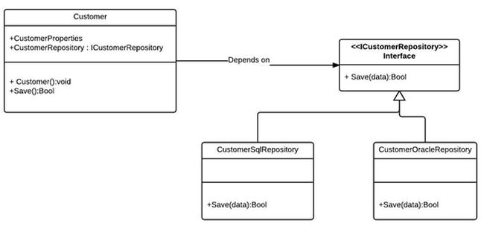
The inversion of control principle

Slide 128
The interface segregation principle
As the interface segregation principle states, clients should not be forced to depend on interfaces they don't use.
This principle talks about software developers writing their interfaces well.
For instance, it reminds the developers/architects to develop methods that relate to the functionality.
If there is any method that is not related to the interface, the class dependent on the interface has to implement it unnecessarily.

Slide 129
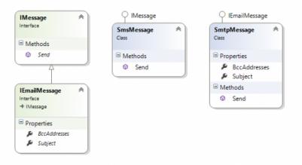
The interface segregation principle

Slide 130
Singleton
Singleton provides you with a mechanism to have one, and only one, object of a given type and provides a global point of access.
Hence, Singletons are typically used in cases such as logging or database operations, printer spoolers, and many others, where there is a need to have only one instance that is available across the application to avoid conflicting requests on the same resource.
For example, we may want to use one database object to perform operations on the DB to maintain data consistency or one object of the logging class across multiple services to dump log messages in a particular log file sequentially.
In brief, the intentions of the Singleton design pattern are as follows:
Ensuring that one and only one object of the class gets created
Providing an access point for an object that is global to the program
Controlling concurrent access to resources that are shared

Slide 131
Singleton

Slide 132
Singleton
A simple way of implementing Singleton is by making the constructor private and creating a static method that does the object initialization.
This way, one object gets created on the first call and the class returns the same object thereafter.
In Python, we will implement it in a different way as there's no option to create private constructors.

Slide 133
Singleton Disadvantages
Global variables can be changed by mistake at one place and, as the developer may think that they have remained unchanged, the variables get used elsewhere in the application.
Multiple references may get created to the same object. As Singleton creates only one object, multiple references can get created at this point to the same object.
All classes that are dependent on global variables get tightly coupled as a change to the global data by one class can inadvertently impact the sother class.

Slide 134
Factory Pattern
The term factory means a class that is responsible for creating objects of other types.
Typically, the class that acts as a factory has an object and methods associated with it.
The client calls this method with certain parameters; objects of desired types are created in turn and returned to the client by the factory.

Slide 135
Factory Pattern
A factory provides certain advantages that are listed here:
The first advantage is loose coupling in which object creation can be independent of the class implementation.
The client need not be aware of the class that creates the object which, in turn, is utilized by the client. It is only necessary to know the interface, methods, and parameters that need to be passed to create objects of the desired type. This simplifies implementations for the client.
Adding another class to the factory to create objects of another type can be easily done without the client changing the code. At a minimum, the client needs to pass just another parameter.
The factory can also reuse the existing objects. However, when the client does direct object creation, this always creates a new object.

Slide 136
Factory Pattern

Slide 137
Factory Pattern
Simple Factory pattern: This allows interfaces to create objects without exposing the object creation logic.
Factory method pattern: This allows interfaces to create objects, but defers the decision to the subclasses to determine the class for object creation.
Abstract Factory pattern: An Abstract Factory is an interface to create related objects without specifying/exposing their classes. The pattern provides objects of another factory, which internally creates other objects.

Slide 138
The Simple Factory pattern
The Factory helps create objects of different types rather than direct object instantiation.
The client class uses the Factory class, which has the create_type() method.
When the client calls the create_type() method with the type parameters, based on the parameters passed, the Factory returns Product1 or Product2:

Slide 139
Factory Pattern

Slide 140
Factory Method Pattern
We define an interface to create objects, but instead of the factory being responsible for the object creation, the responsibility is deferred to the subclass that decides the class to be instantiated.
The Factory method creation is through inheritance and not through instantiation.
The Factory method makes the design more customizable. It can return the same instance or subclass rather than an object of a certain type (as in the simple factory method).

Slide 141
Advantages of the Factory method pattern
It brings in a lot of flexibility and makes the code generic, not being tied to a certain class for instantiation.
There's loose coupling, as the code that creates the object is separate from the code that uses it.
The client need not bother about what argument to pass and which class to instantiate. The addition of new classes is easy and involves low maintenance.

Slide 142
The Abstract Factory pattern
The main objective of the Abstract Factory pattern is to provide an interface to create families of related objects without specifying the concrete class.
While the factory method defers the creation of the instance to the subclasses, the goal of Abstract Factory method is to create families of related objects.

Slide 143
The Factory method versus Abstract Factory method

Slide 144
The Abstract Factory pattern

Slide 146
Questions

Slide 147
Module Summary
Regular Expressions
Generators, Decorators and Iterators
Socket and Network Programming
Image Handling
Processes and Threads
Design Patterns

